Slide 1
Data Ethics The Influence of Customer Behaviour

Slide 2

2012 – Consumer Classification
2012
Father discovers 15 year old daughter is pregnant from mail posted to her from Target
Assign a Customer Id to everyone using either email, credit card or name as the matching public key
Leveraged own and brought data. Identified correlations that when 25 attributes came together to form a “Pregnancy Score”
Evolved to combined targeted with non-targeted adverts, avoid sense of spying – greater chance that customer will use coupon

Slide 3
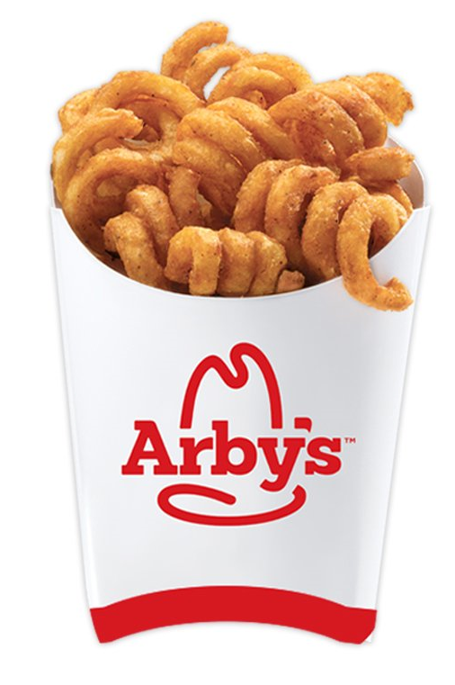
Spread of Information Driving Classification
Social
Influencer
Driver
Analytical
Imitation might play a greater role than we might perceive
Social
Copying**
Personality Types
Amiable
Expressive
Social Learning
Classified by Your Likes*
The Godfather
Mozart
Thunderstorms
Morgan Freemans Voice
Lord of the Rings
To Kill a Mocking Bird
Science
Curly Fries
Jason Aldean
Tyler Perry
Sephora
Chiq
Bebe
I Love Being a Mum
Harley Davidson
Lady Antebellum
Mojo-Jojo
Biology
Hillary
106 & Park
Jennifer Lopez
Paid in Full
Yo Gotti
The dollar you are holding could’ve been in a stripper’s b#tt crack
The Dark Knight
In ‘n’ Out Burger
Hard Rock
Honey, where is my supersuit
Hating ICP
Minecraft
Iron Maiden
Walking with friends and randomly pushing them into someone
Highest IQ
Many Friends
Few Friends
Low IQ
* Proceedings of the National Academy of Science USA and Report Results
** http://www.paulormerod.com/wp-content/uploads/2012/06/OrmerodBentley_CS_30Nov10-RA2.pdf

Slide 4
Homophily
The tendency for people to have (non-negative) ties with people who are similar to themselves in socially significant ways

Slide 5
Generational Differences Brazil Case Study*
Don’t define yourself in one way
“omni-identified”
B
X
Y
Z
1946 - 1964
1965 - 1980
1981 - 2002
1995+
Context
Postwar
Dictatorship and repression
Political transition
Capitalism and meritocracy dominate
Globalisation
Economic stability
Emergence of internet
Mobility and multiple realities
Social networks
Digital natives
Behaviour
Idealism
Revolutionary
Collectivist
Materialistic
Competitive
Individualistic
Globalist
Questioning
Oriented to self
Undefined ID
Communaholic
Dialoguer
Realistic
Consumption
Ideology
Vinyl and movies
Status
Brands and cars
Luxury articles
Experience
Festivals and travel
Flagships
Uniqueness
Unlimited
Ethical
* McKinsey Multi-Generational Impact on Companies - Brazilian Case Study

Slide 6
How Generations Compare
Characteristics | Maturists (pre-1945) | Baby Boomers (1945-1960) | Gen X (1961-1980) | Gen Y (1981-1995) | Gen Z (1995+)
Formative Experiences | War, Rationing, Defined Gender Roles, Nuclear Families | Cold-war, Space Travel, Youth Culture, Teenager, Family Orientated | Live Aid, Fall of Berlin Wall, Intro of PC, Rising Divorce Levels | 9/11, Playstation, Social Media, Irag, Reality TV, Google, Glastonbury | Economic Downturn, Global Warming, Mobile, Global, Cloud, Produce Own Media
% in UK Workforce | 3% | 33% | 35% | 29%
Aspiration | Home Ownership | Job Security | Work/Life Balance | Freedom and Flexibility | Security and Stability
Attitude Toward Tech | Largely Disengaged | Early IT Adapters | Digital Immigrants | Digital Natives | Technoholics
Attitude Toward Career | Jobs are for Life | Careers Defined by Employers | Loyal to Profession | Digital Entrepreneurs | Career Multitaskers
Signature Product | Automobile | Television | Personal Computer | Tablet / Smart Phone | Google Glass, AI, Nano Computing
Communication Media | Formal Letter | Telephone | Email and Text | Text or Social Media | Hand-held Comms
Communication Preference | Face-to-Face | Face-to-Face, but growing use of telephone and email | Text or email | Online and mobile | Facetime
Financial Decision Preference | Face-to-Face | Face-to-Face, but will go online | Online – prefer Face-to-Face | Face-to-Face | Digitally Sourced Solutions

Slide 7
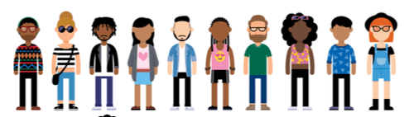
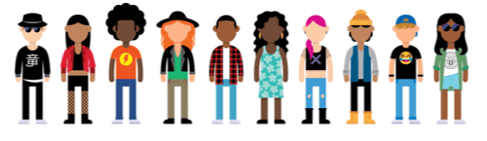
Perception of Data Protection
It is the Rock and Roll, Elvis, Beatles, Woodstock, Miniskirts, Barbie generation. The first two-income household generation, the first TV generation, the first divorce generation, where divorce was beginning to be accepted as a tolerable reality. The first tolerant generation. Envision technology and innovation as requiring a learning process**
I am always connected — but avoid social situations. I demonstrate a firm attention to detail — but have the attention span of a goldfish. I freely give out personal information — but demand it be protected. I distrust corporations — but communicate to them as if they were family*
** Baby Boomer Generation
* Generation Z

Slide 8
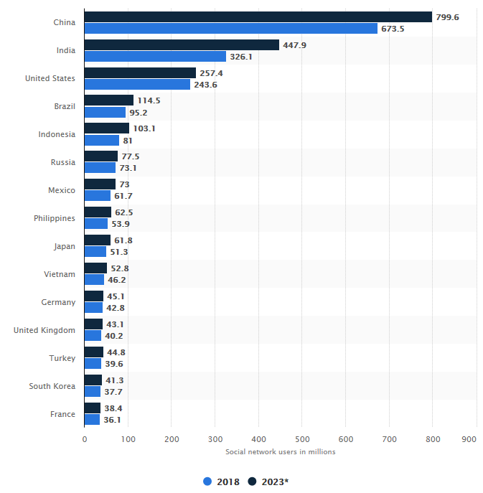
Social Media Isn’t the Best Guide
Generation X (ages 35-49) spends the most time
on social media: almost 7 hours per week versus
Millennials, who come in second, spending
just over 6 hours per week.
Heavy Social Media Users (3+ Hours/Day)
Rank | Social Activity | %
1 | Visit friends page or profile | 57
2 | Comment on friend’s post | 55
3 | Sent a message or email | 50
4 | Watched a video | 50
5 | Posted picture(s) | 50
6 | Posted “Like” | 47
7 | Updated status | 42
8 | Updated profile | 30
9 | Followed or became “fan-of” someone | 25
10 | Played a game | 23
No# Social Network Users
Nielsen Social Media Report

Slide 9
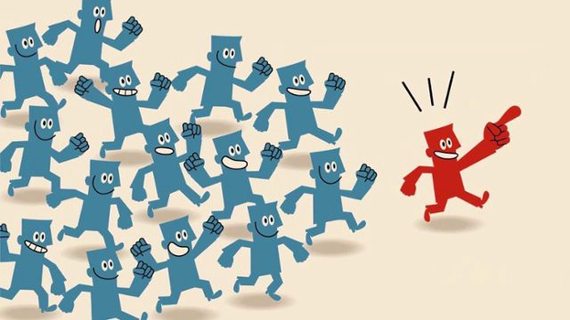
Social Influencers
Who Are They?
Credibility & Power
Everyday people passionate about a particular topic
Credability
Expertise
Attractiveness
Similarity
Post on social media, gained huge popularity by sharing opinions through blogs, videos, pictures, tweets, etc
Social Proof**
Strength through volume of shares, followers, likes, etc
Level of Influence reflects popularity, and power to spread the word - Paul Revere 1775
Power of Social Media Influencers
** Social Proof Theory

Slide 10






Importance of Data Privacy
Expressing Concern
Trust
Identity Theft, Financial Fraud, Personal Data Sold or Shared Without Consent, Mis-use, Government Surveillance
73% surveyed believe that companies are collecting their personal information without their knowledge
78%
Baby Boomers
29%
66%
Millennials
21%
20%
18%
16%
Level of Trust
14%
Energy Companies
Internet Providers
Retail
Travel Comp.
Social Media
72%
Gen Xers
Government
SAS: Data Privacy Across Generational Divide

Slide 11
Perception
Data Pragmatist: those who will make trade-offs on a case-by-case basis as to whether the service or enhancement of service is worth the information requested
% Agree – PI Sharing is essential
Segmentation
Data Fundamentalist: those unwilling to provide personal information even in return for service enhancement
Data Unconcerned: those who are unconcerned about the collection and use of personal information about them
% Agree – PI is an asset – Better prices and offers
Data & Marketing Organisation

Slide 12
How Does This Impact Ethics?
Transparency

Slide 13
Where Next?
Am I Being Data Ethical?
Understand the difference between ethical and appropriate
Sensitive to the issues of people’s lives
Are you trying to cause harm?
Is your action immoral?
Is what you are doing illegal?

